Slide 1

401(k) Portfolio Optimizer
Optimize and visualize your 401(k) portfolio with the right allocation of stocks, bonds, and other funds.

Slide 2
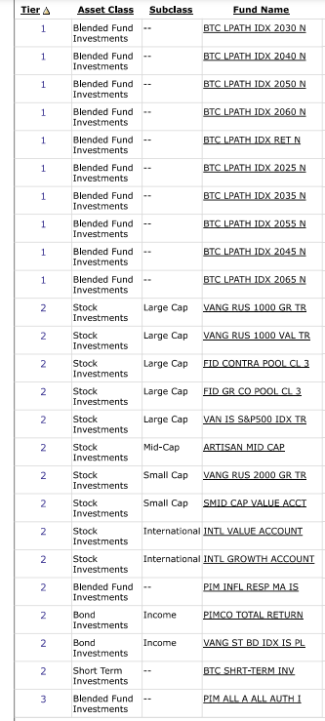


Slide 3
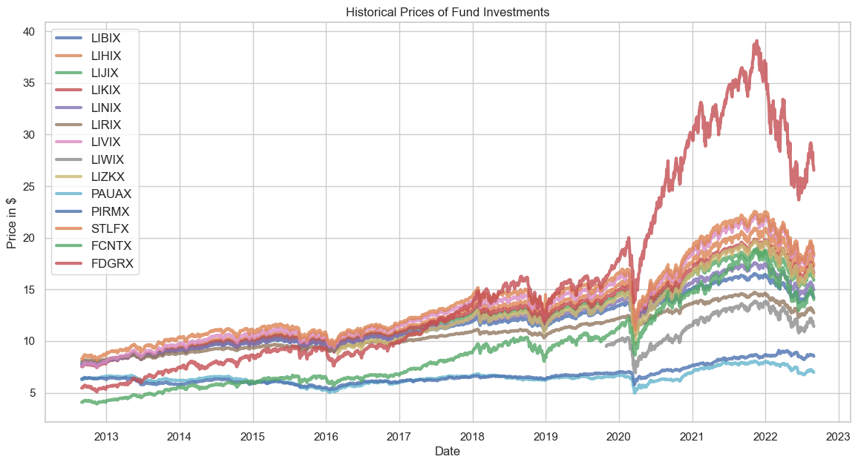
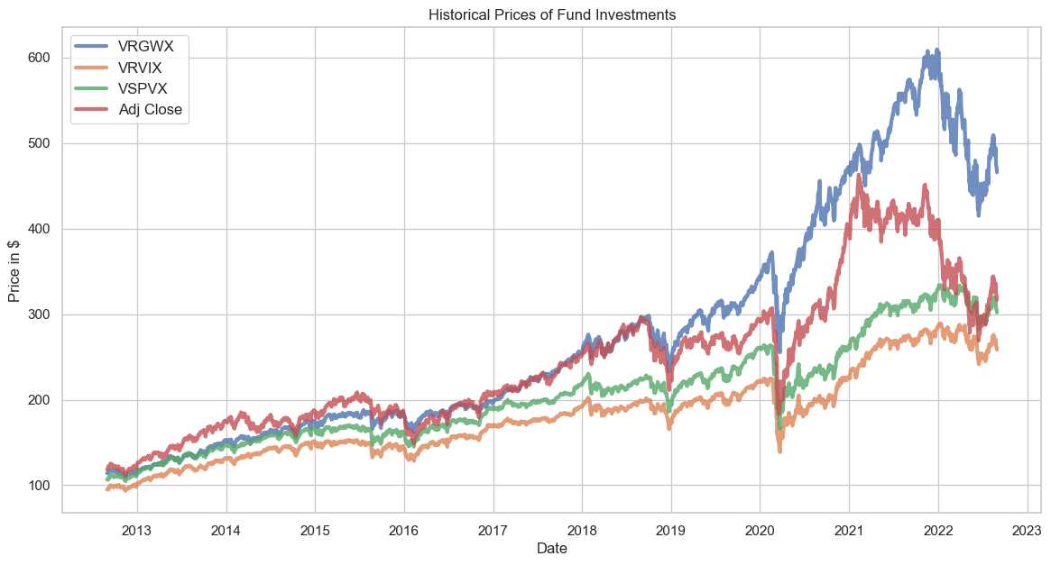
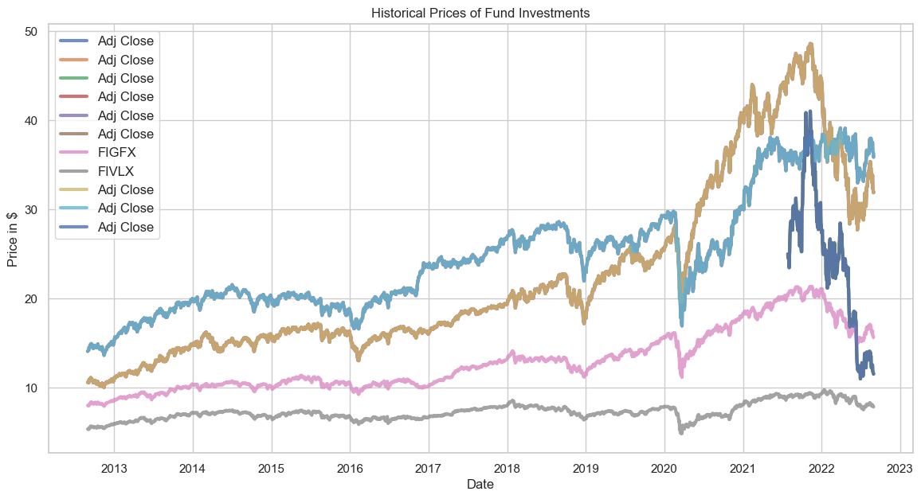
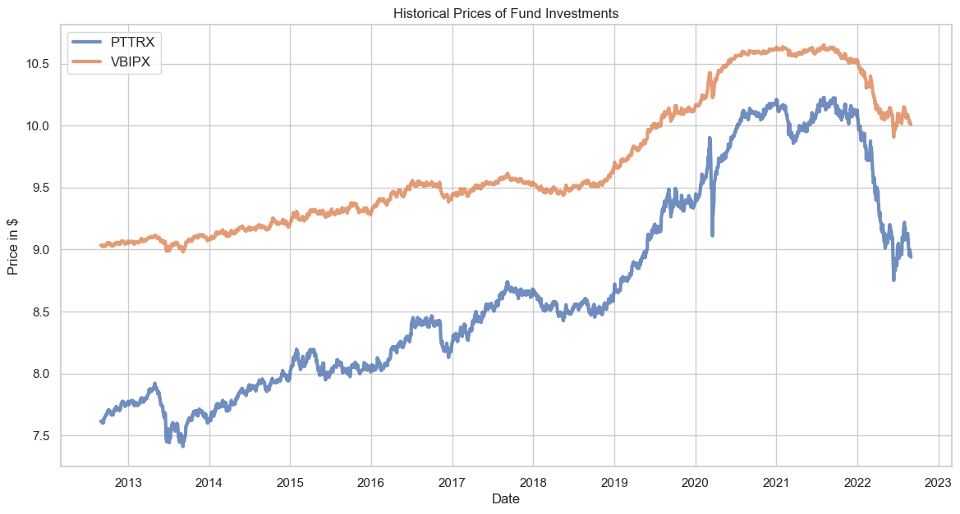
Historical Prices of Different Asset Classes
Blended Funds
Large-cap, Mid-cap
Small-cap, International
Kick-off project
Research
Build personas
Define journey
Design exploration
Design revisions
Bond Investments
Revise
Development

Slide 4
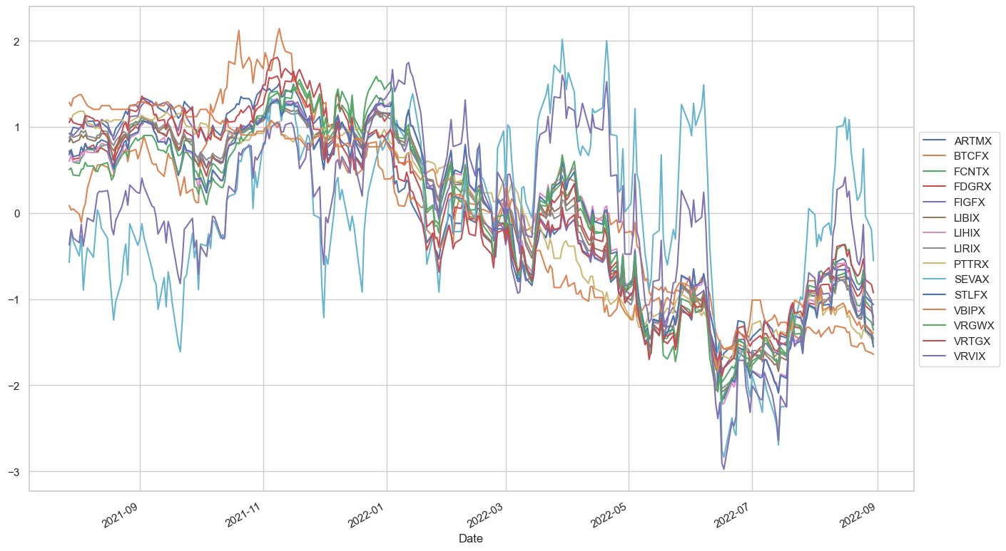
Historical Prices | Standardized

Slide 5
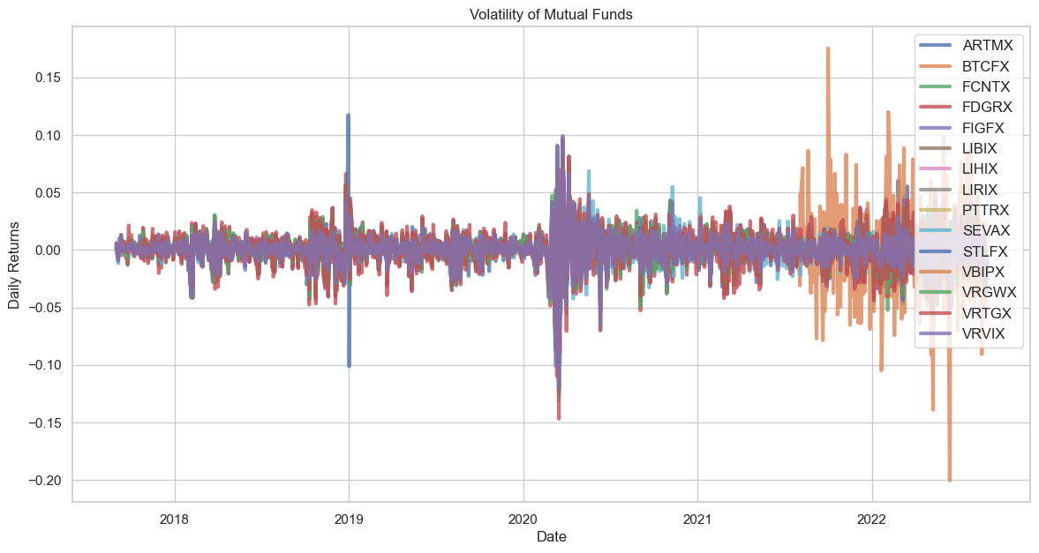
Volatility

Slide 6
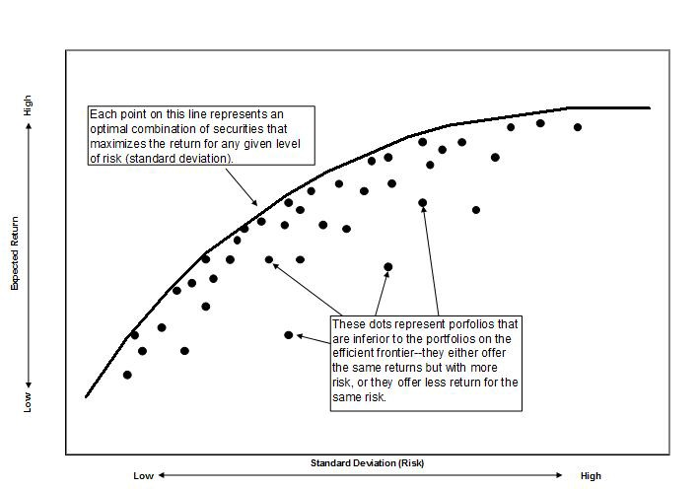
Modern Portfolio Theory
Efficient Frontier

Slide 7
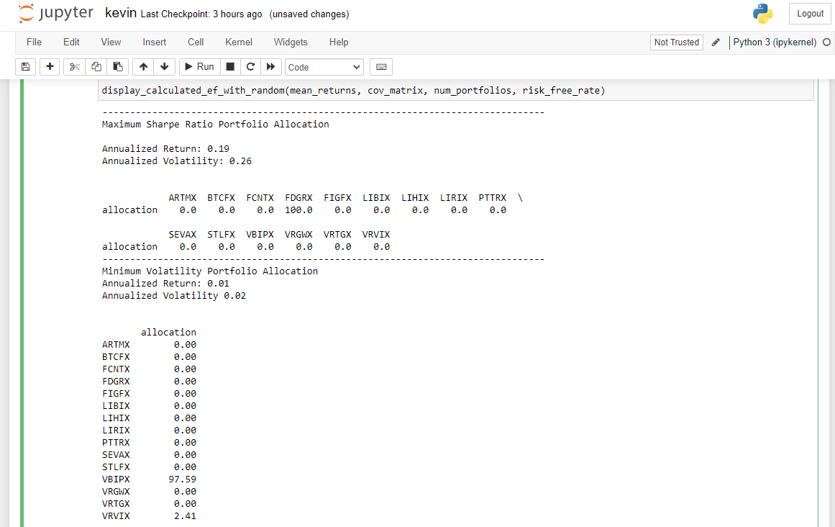

Slide 8
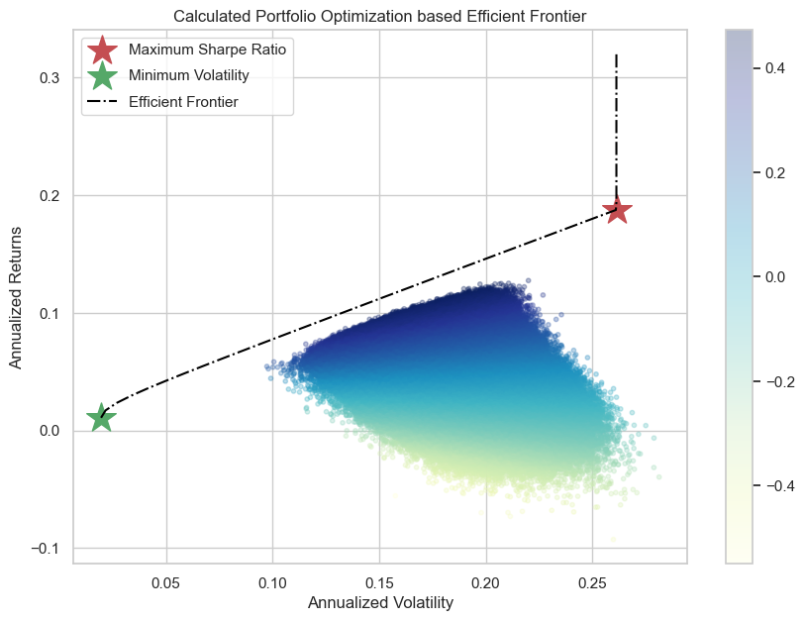

Slide 9
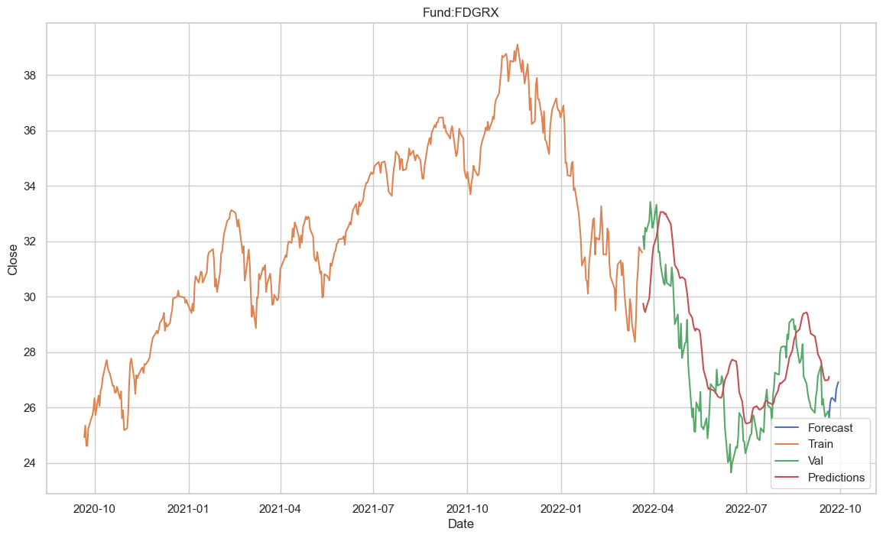
Forecasting Model
A Long Short Term Memory (LSTM) model has been developed to forecast each fund performance over the next period (for example, one week).
LSTMs are a particular type of RNNs (Recurrent Neural Networks) that help in solving the long-term dependency problem and are extremely useful when dealing with time series.
The past two years of data is used for model training and validation.
The model can be updated on a regular basis to guide user’s investment decision

Slide 10


Resources
Hackbox
Github
https://hackbox.microsoft.com/project/2279
https://github.com/ksun0/401k-optimizer
Contact
Other Contributors
Kevin Sun (sunkev)
Caiwen Wu (caiwenwu)
Ayan Shafqat
Bharath Meadam
Elsie Chen
Siddhant Agarwal

Slide 11
Thank you

